Slide 1



DEPARTMENT OF ARTIFICIAL INTELLIGENCE AND MACHINE LEARNING
SCHOOL OF COMPUTING
10214AM601 MINOR PROJECT -2
WINTER SEMESTER(2023-2024)
REVIEW-1
“FIBROINSIGHT: AI-ENABLED PULMONARY FIBROSIS PROGNOSIS”
SUPERVISED BY
PRESENTED BY
Dr. JEEVANANTHAM,ME,PhD
1.A.N.P. SRI CHARITH (VTU19917)(21UEAM0003)
2.M.V. SAI KUMAR (VTU19945)(21UEAM0040)
3.U.SRIKANTH REDDY (VTU20364)(21UEAM0067)

Slide 2
OVERVIEW
ABSTRACT
OBJECTIVE
INTRODUCTION
LITERATURE REVIEW (SOFT COPY OF PAPERS TO BE LINKED AS HYPERLINK)
DESIGN AND METHODOLOGIES
IMPLEMENTATION
TESTING
INPUT AND OUTPUT
INCLUDE DEMO VIDEO-1 (Till REVEW-1)
INCLUDE DEMO VIDEO-2(Complete Implementation of Project)
CONCLUSION
WEB REFERENCES LINK (TILL REVIEW DATE ALL LINKS TO BE INCLUDED DAY WISE)
PLAGIARISM REPORT OF PPT
REFERENCES

Slide 3
ABSTRACT
This project focuses on employing machine learning techniques for predicting lung function in patients with pulmonary fibrosis.
Utilizing a dataset OSIC Pulmonary Fibrosis Progression curated for pulmonary fibrosis progression, the study aims to develop predictive models for Forced Vital Capacity (FVC) rates.
Forced Vital Capacity rate is a variable for determination of lung health. It also helps in determination of the oxygen present in lungs.
Various machine learning algorithms are explored and evaluated for their effectiveness in accurately predicting FVC values.
Especially we aim to various classification and regression algorithms like SVM- support vector machine , LASSO – least absolute shrinkage and selection.
Feature engineering methods are employed to extract relevant information from medical imaging data and clinical metadata.
The research contributes to the advancement of medical diagnostics by offering computational tools for early detection and monitoring of pulmonary fibrosis progression.

Slide 4
OBJECTIVES
1.Aim of the project
The primary objective of this project is to employ machine learning techniques to develop predictive models capable of estimating lung function, with a specific focus on predicting Forced Vital Capacity (FVC) rates, among individuals diagnosed with pulmonary fibrosis.
These models aim to leverage advanced computational methods to provide accurate predictions of lung function progression in patients with pulmonary fibrosis, thereby aiding in disease management and treatment planning.
By utilizing machine learning algorithms and appropriate feature engineering techniques, this research endeavors to contribute to the advancement of medical diagnostics and enhance our understanding of pulmonary fibrosis progression.
Ultimately, the goal is to develop reliable computational tools that healthcare professionals can utilize for early detection, monitoring, and personalized management of pulmonary fibrosis.

Slide 5
OBJECTIVES
2.Scope of the project
Data Collection and Preprocessing: Gathering and preprocessing a comprehensive dataset consisting of imaging data (DICOM format) and relevant clinical metadata from individuals diagnosed with pulmonary fibrosis.
Feature Engineering: Employing advanced feature engineering techniques to extract meaningful features from the imaging data and metadata to facilitate accurate prediction of lung function.
Model Development: Exploring various machine learning algorithms, including but not limited to regression and ensemble methods, to develop predictive models for estimating Forced Vital Capacity (FVC) rates.
Evaluation and Validation: Assessing the performance of developed models through rigorous evaluation metrics and cross-validation techniques to ensure their robustness and reliability.
Interpretability and Clinical Application: Interpreting model outcomes and insights to provide clinically relevant information that can assist healthcare professionals in disease management and treatment decision-making for individuals with pulmonary fibrosis.

Slide 6
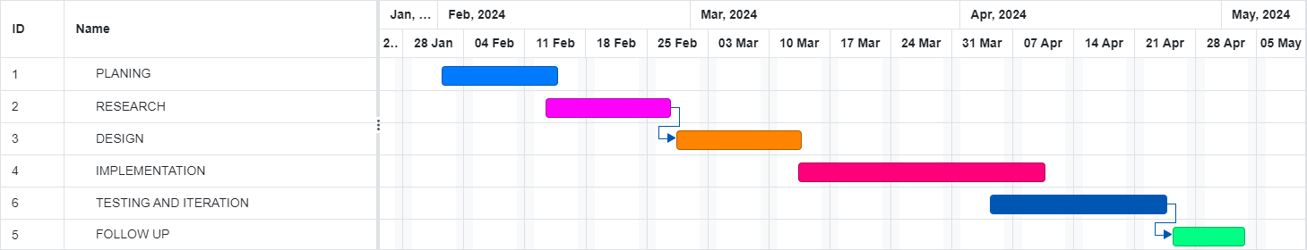
TIMELINE OF THE PROJECT
Gantt chart

Slide 7
INTRODUCTION
Pulmonary fibrosis represents a progressive lung pathology characterized by the gradual scarring of lung tissue, necessitating precise measurement of Forced Vital Capacity (FVC) rates crucial for diagnosis and therapeutic intervention.
Conventional assessment methodologies often lack the precision required to discern subtle changes in pulmonary fibrosis progression, prompting the exploration of more advanced diagnostic approaches.
This project seeks to harness the power of machine learning techniques and medical imaging data, specifically DICOM images and accompanying clinical metadata, to develop predictive models capable of estimating FVC rates in individuals afflicted with pulmonary fibrosis.
By employing sophisticated feature engineering methods and a diverse array of machine learning algorithms, including regression and ensemble techniques, the aim is to refine the accuracy and robustness of these predictive models.
The anticipated outcomes of this research endeavor hold significant promise in advancing clinical decision-making processes, facilitating early disease detection, and tailoring personalized management strategies for patients grappling with pulmonary fibrosis, thereby fostering improved patient outcomes and overall quality of life

Slide 8
LITERATURE REVIEW
Author’s Name | Paper name and publication details | Year of publication | Main content of the paper
Sampurna Mandal; Valentina E. Balas; Rabindra Nath Shaw; Ankush Ghosh | Prediction Analysis of Idiopathic Pulmonary Fibrosis Progression from OSIC Dataset | 2020 IEEE International Conference on Computing, Power and Communication Technologies (GUCON) | This paper aims to analyze and compare the performance of various machine learning models in predicting forced volume capacity measurements and confidence values from CT scan data, facilitating early diagnosis and efficient resource allocation in managing pulmonary fibrosis.
R Keerthana; Sindu Divakaran; S Nisha | A robust deep learning method for radiation induced pulmonary fibrosis disease classification in lung CT-a review | 2022 International Conference on Power, Energy, Control and Transmission Systems (ICPECTS) | Developing a deep learning model, I-CRAWL, to accurately segment pulmonary fibrosis (PF) lesions from CT scans, overcoming challenges like varied lesion characteristics and limited annotated data. The model integrates semi-supervised learning, image pre-processing, segmentation, feature extraction, and classification steps, aiming to facilitate precise diagnosis and treatment monitoring of PF using CT imaging.

Slide 9
LITERATURE REVIEW
Author’s Name | Paper name and publication details | Year of publication | Main content of the paper
Upasana Chutia; Anand Shanker Tewari; Jyoti Prakash Singh | Analysis of Idiopathic Pulmonary Fibrosis through Machine Learning Techniques | 2021 8th International Conference on Smart Computing and Communications (ICSCC) | This aim to predict lung function decline in Idiopathic Pulmonary Fibrosis (IPF) patients, aiding in medication optimization and prolonging patient longevity. Early detection is crucial to mitigate morbidity, mortality, and healthcare costs.
Angeliki Poulou; Marios Poulos; Maximilianos Panas | A regression-based machine learning approach for the prediction of lung function decline | 2022 12th International Conference on Dependable Systems, Services and Technologies (DESSERT) | Pulmonary fibrosis is a progressive lung disease where early detection is critical. In the Kaggle competition "OSIC Pulmonary Fibrosis Progression Predict lung function decline," our approach achieved a Laplace Log Likelihood score of -6.8590, earning a bronze medal. Using CT scans and clinical data, including spirometry FVC measurements, from 176 patients, we developed a simple yet accurate model to predict lung function decline by estimating FVC and a confidence measure through a sigmoid equation derived from a novel transformation of three parameters.

Slide 10
DESIGN AND METHODOLOGIES
MODULE 1: EXPLORTORY DATA ANAYSIS
This helps in data analysis like univariate , bi-variate and multi variate using various graphs.
MODULE 2: META DATA AND DICOM DATA ANALYSIS
This includes processing data cleaning it and making it ready to implement algorithms.
MODULE 3: MODEL SELECTION
Selecting and trying various machine learning models to find which one is best.
MODULE 4: TRAINIG AND TESTING
Training and Testing the model to find the accurate and mot helpful model.
MODULE 5: EVALUATION
Evaluating model based on laplace log likelihood metric using forced vital capacity.

Slide 11
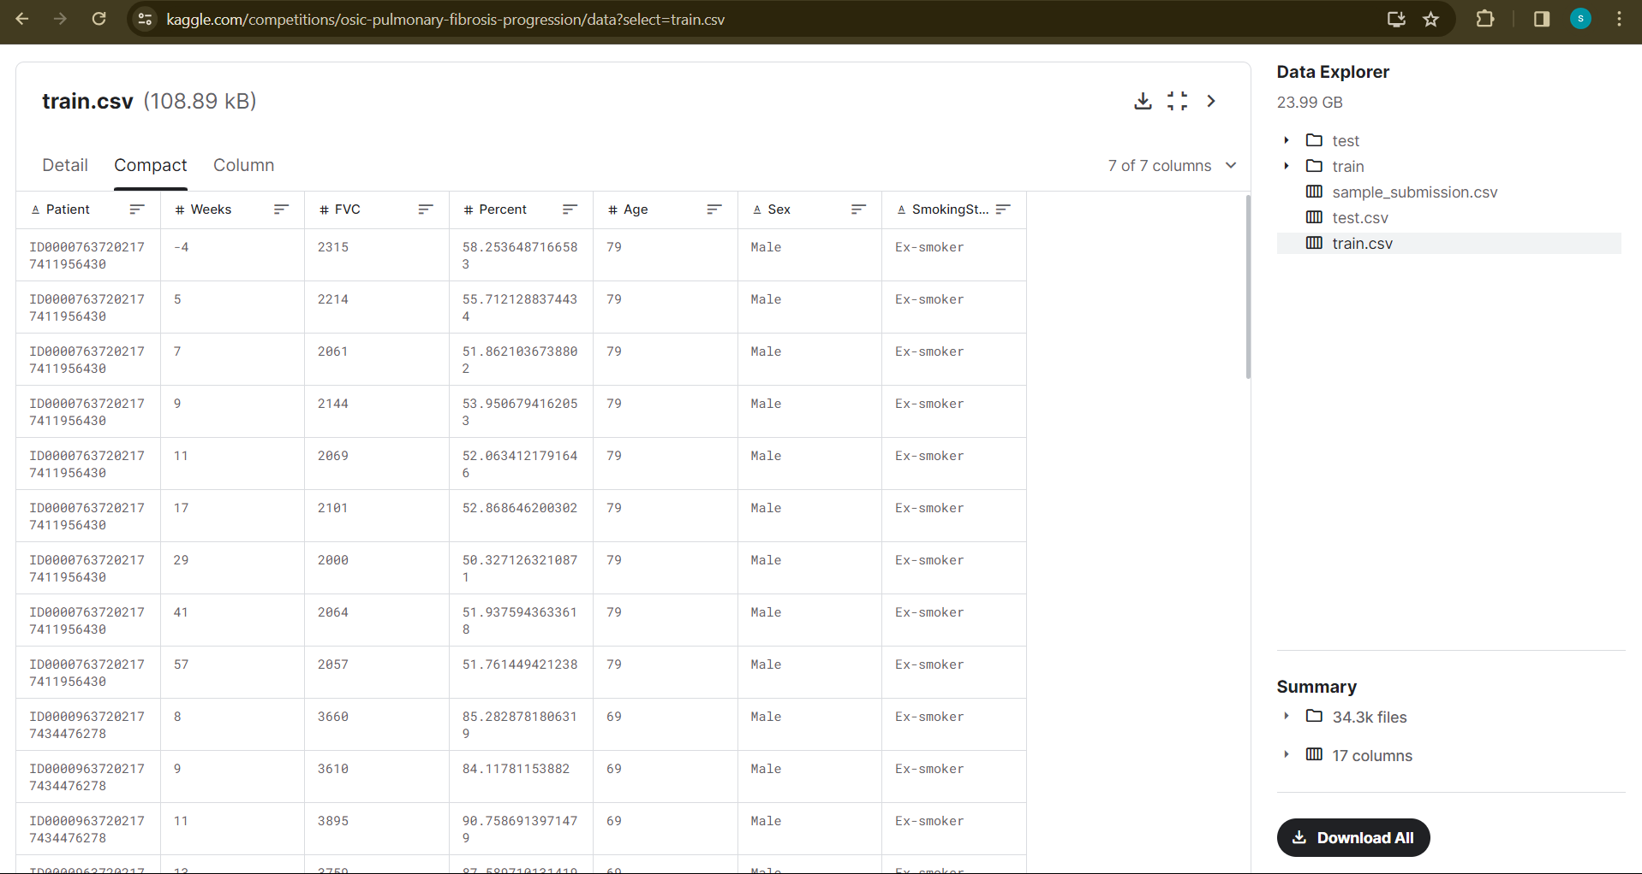
MODULE 1: EXPLORATORY DATA ANALYSIS
Step 1: collecting data
For predicting lung function we are using OSIC Pulmonary Fibrosis Progression dataset.
This has train and test data with dicom data for image analysis.

Slide 12
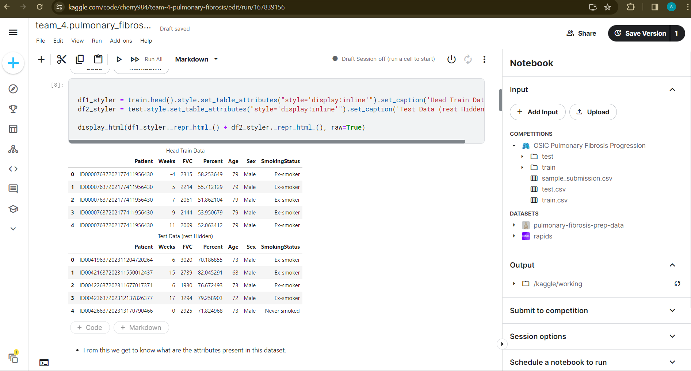
Step 2: Processing the data
the collected data will be processed by cleaning data and removing null values.
Since it is an large dataset this is done by using various python libraries like pandas, numpy.

Slide 13
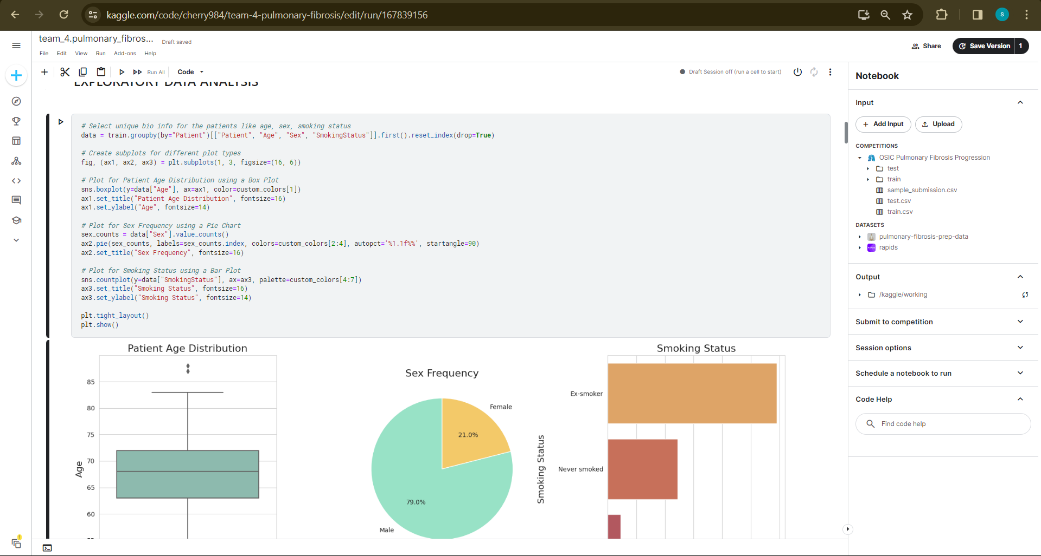
MODULE 2: META DATA AND DICOM DATA ANALYSIS
Meta data is data is a data that provides content about other data.
Here we use metadata analysis to visualize and understand the dataset and its variables.

Slide 14
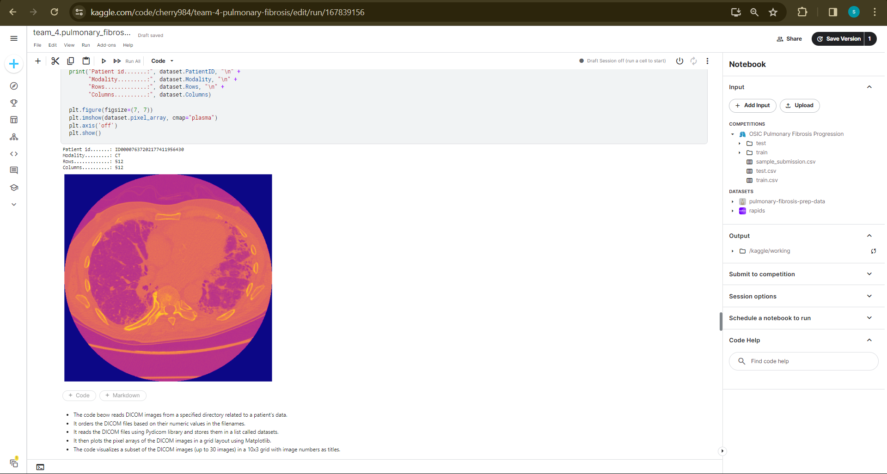
Dicom data is image data stored in dicom file format. This is also used to visualize the images of lungs in gif or apply various masks in lungs.

Slide 15
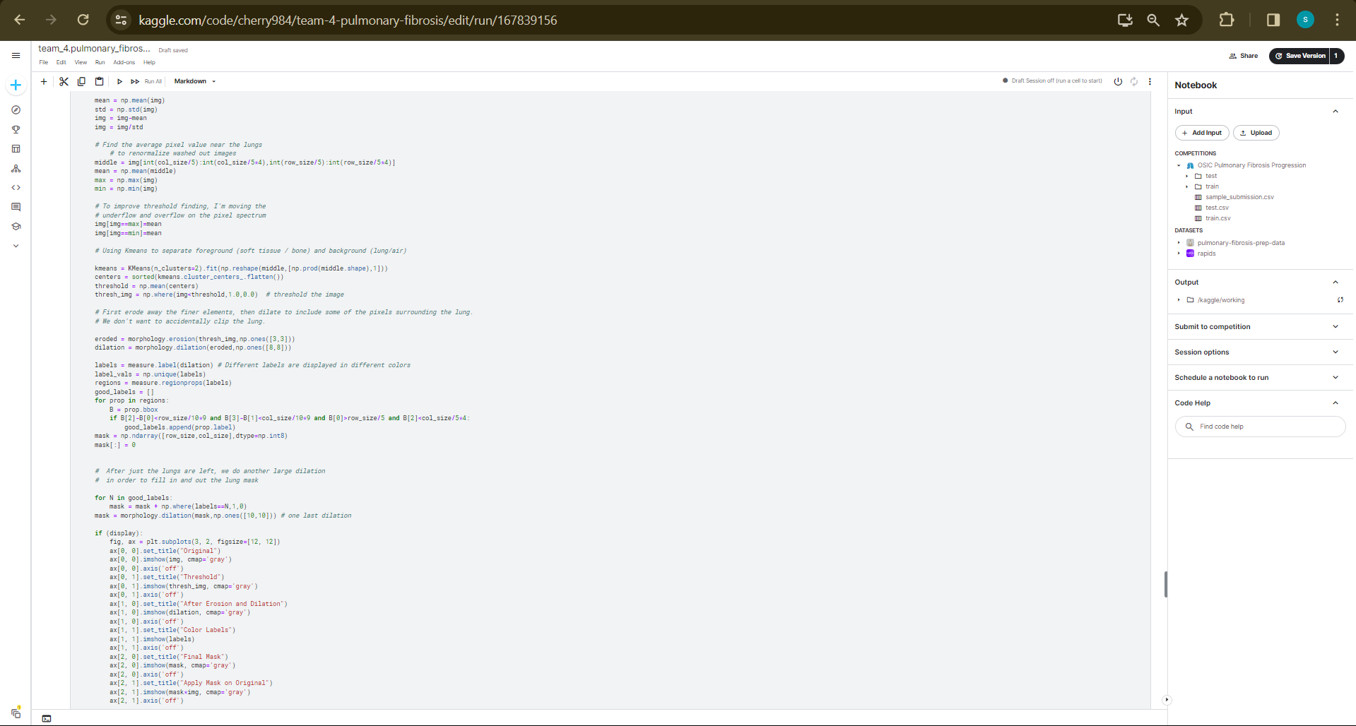
Step 3: Using various masks to identify lung distortion

Slide 16
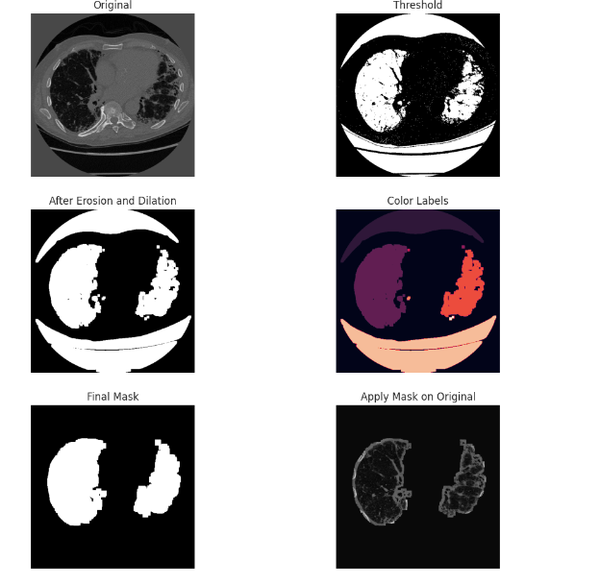
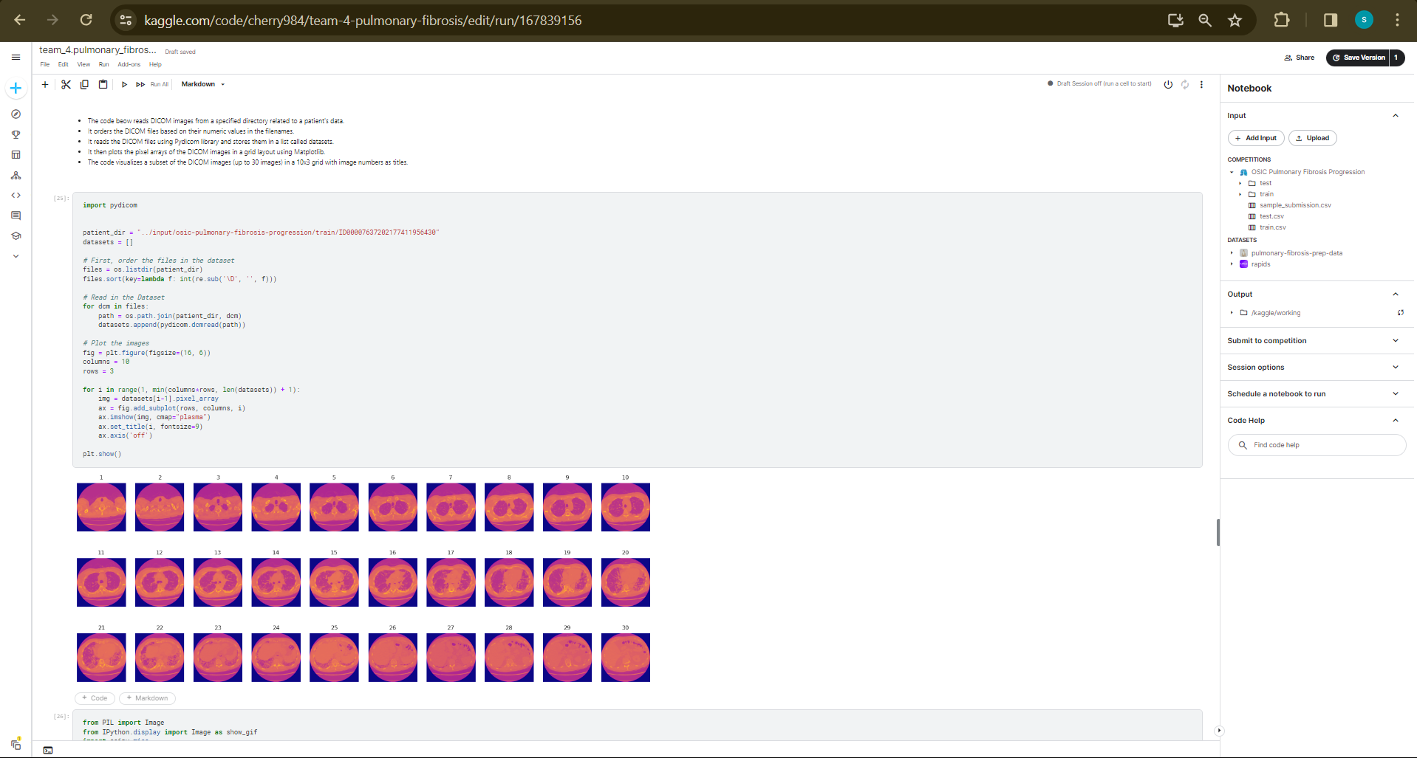
Step 4: The output

Slide 17
IMPLEMENTATION
Architecture Diagram
Data –Flow Diagram
Class Diagram
Activity Diagram
Sequence Diagram
Collaboration Diagram(If applicable)
E-R Diagram

Slide 18
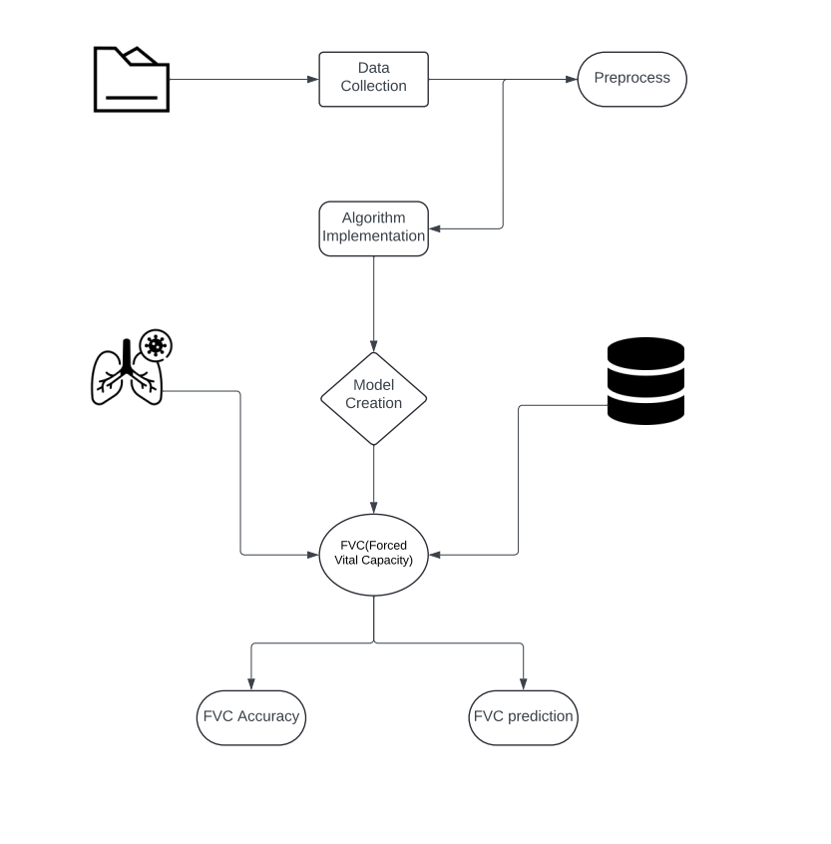
Architecture Diagram
Data Input:
The system receives patient data, including chest X-ray images and medical history information, represented by the "Patient Data" class.
Preprocessing:
The received data undergoes preprocessing tasks such as image resizing, format conversion, and noise reduction, handled by the "Preprocessing Module" class.
Feature Extraction:
After preprocessing, relevant features are extracted from the data, which could include image intensity values or textures, performed by the "Feature Extraction Module" class.
Machine Learning Model:
The extracted features are then fed into the "Machine Learning Model" class, which represents a trained model capable of predicting the presence of pulmonary fibrosis based on the input features.
Prediction Output:
Finally, the system generates a prediction output, represented by the "Prediction" class, indicating whether the input chest X-ray image shows signs of pulmonary fibrosis or not.

Slide 19
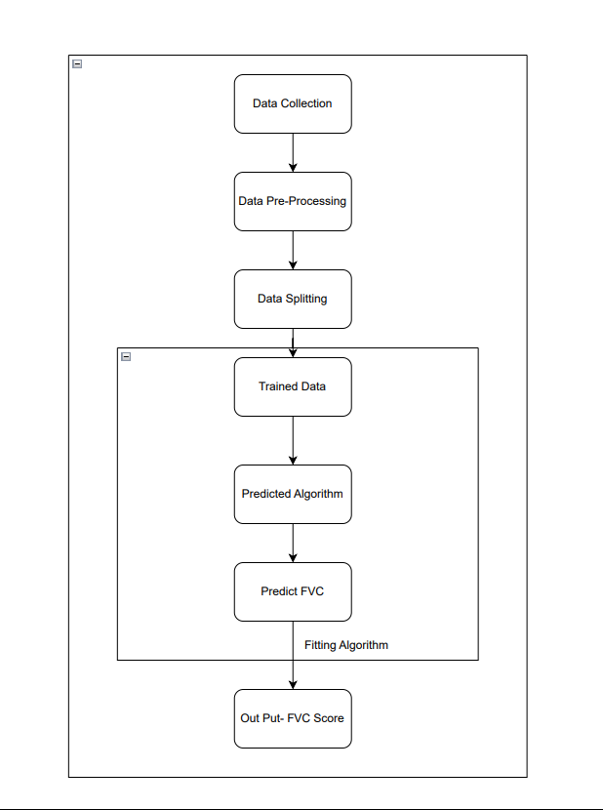
Data –Flow Diagram
The above diagram represents the flow of data which starts from dataset osis pulmonary fibrosis and then initiated into various parts of code. It is shown that this dataset has three sub files named train , test and sample data.

Slide 20
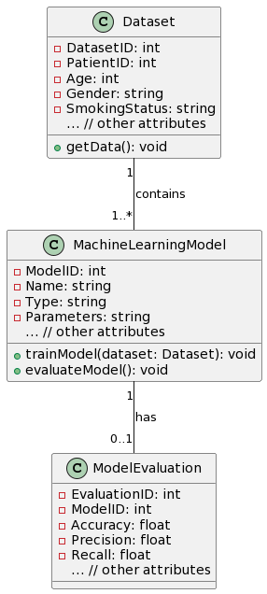
Class Diagram

Slide 21
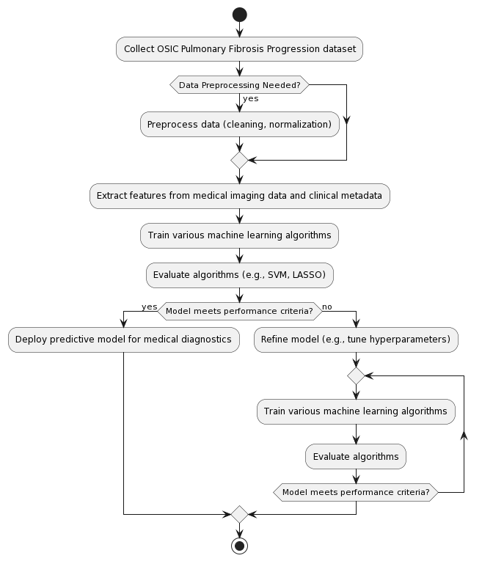
Activity Diagram

Slide 22
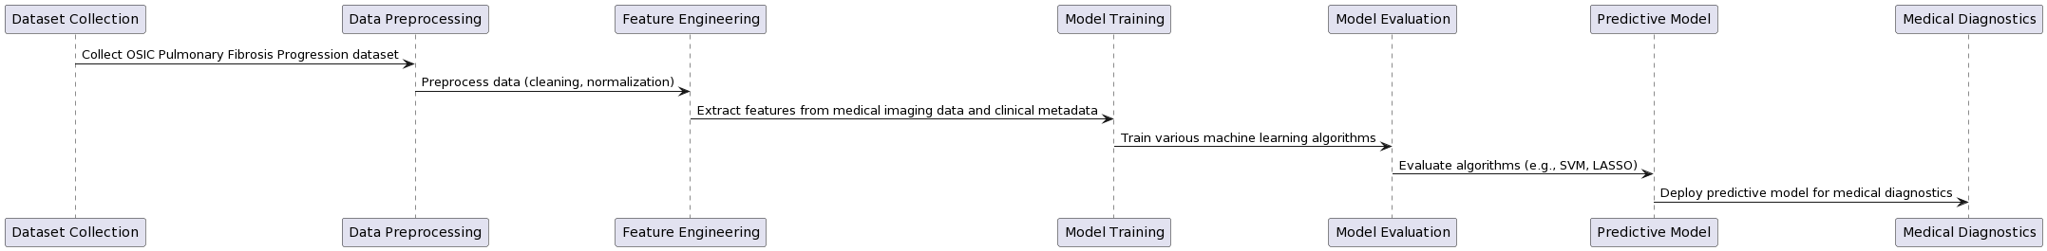
Sequence Diagram

Slide 23
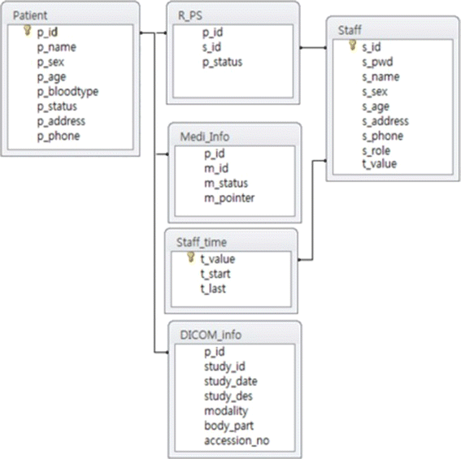
E-R Diagram

Slide 24
TESTING
UNIT TESTING
FUNCTIONAL TESTING

Slide 25
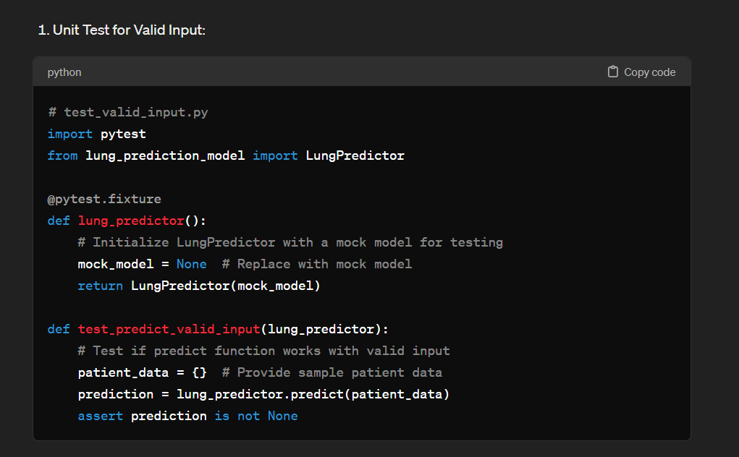
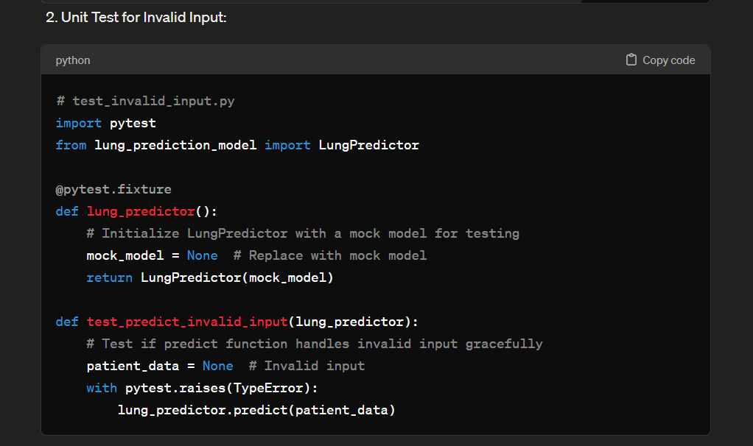
UNIT TESTING
Unit testing involves testing individual components of the software program or application. The main purpose behind this is to check that all the individual parts are working as intended. A unit is known as the smallest possible component of software that can be tested.
System testing and integration testing are not applicable for this project as it is a predictive model and has no external integration software.

Slide 26
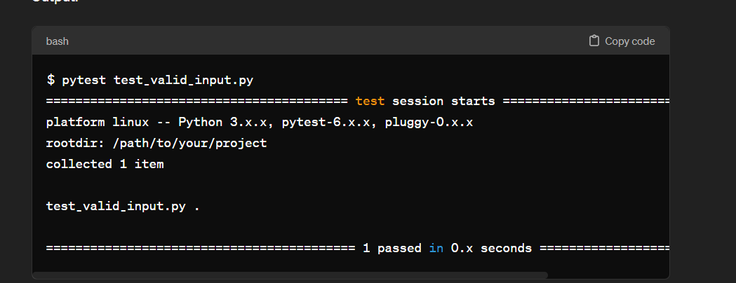
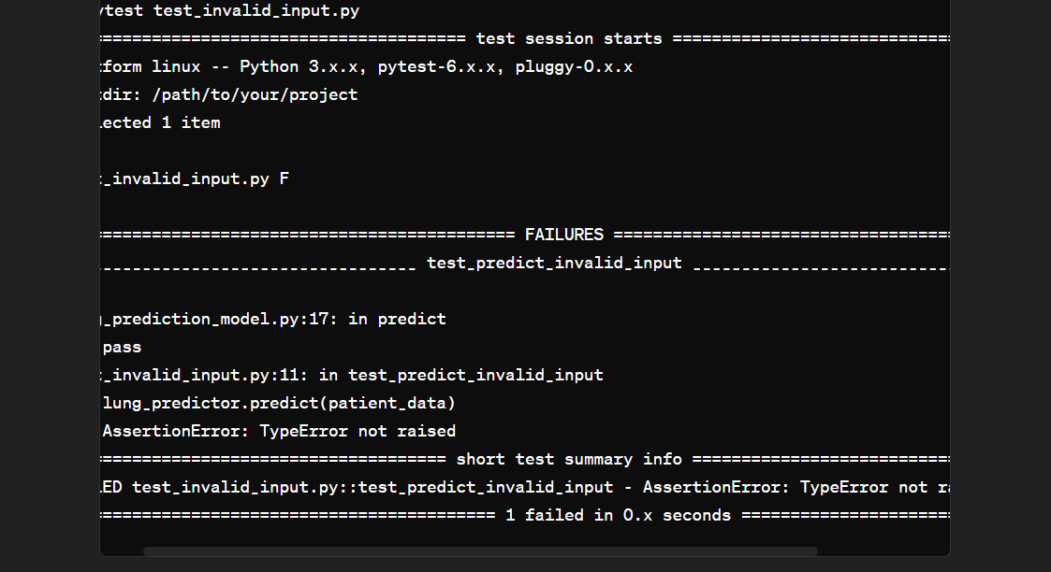
UNIT TESTING OUTPUT
This shows two unit tests with one valid input and other invalid input. Valid input file the test passed and returned model and when invalid input the test return an exception.

Slide 27
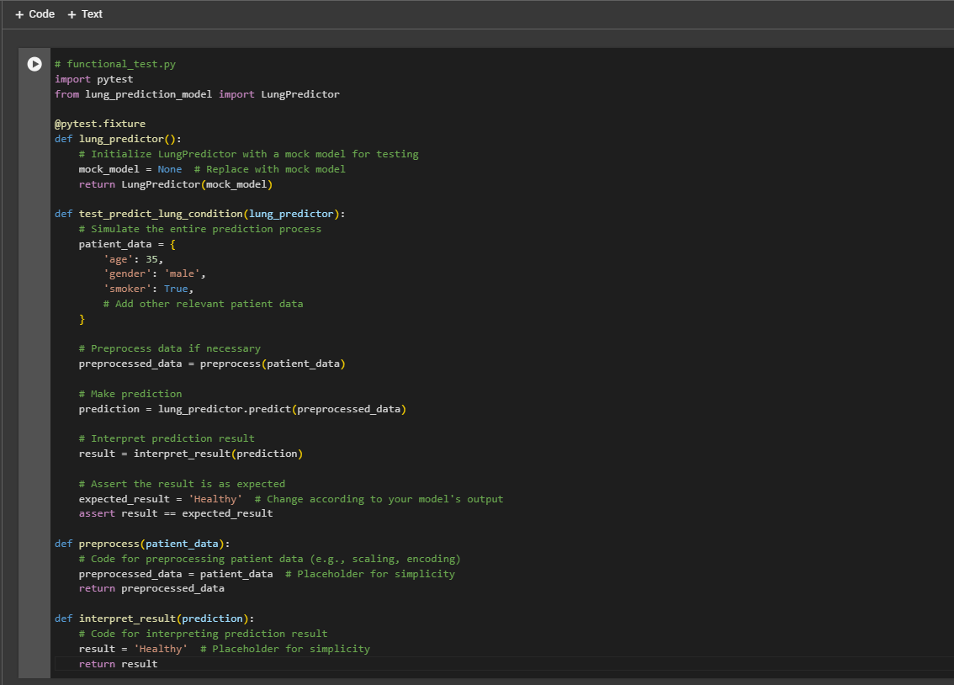
FUNCTIONAL TESTING

Slide 28
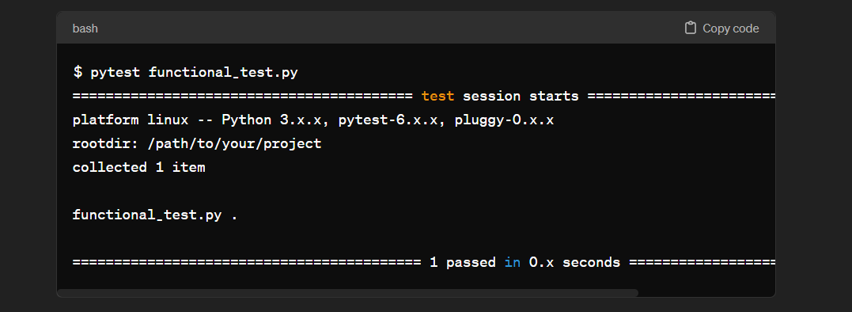
FUNCTIONAL TESTING OUTPUT

Slide 29
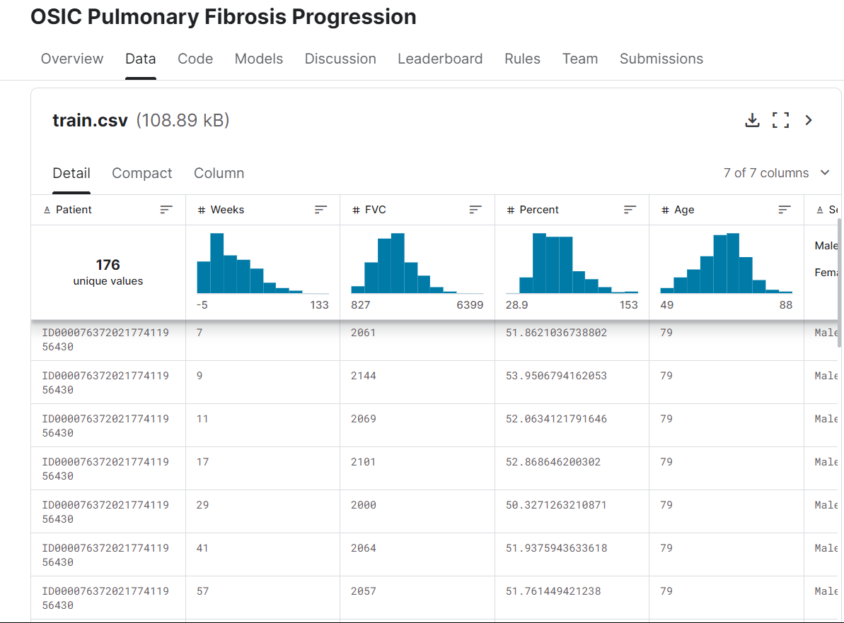
INPUT AND OUTPUT

Slide 30
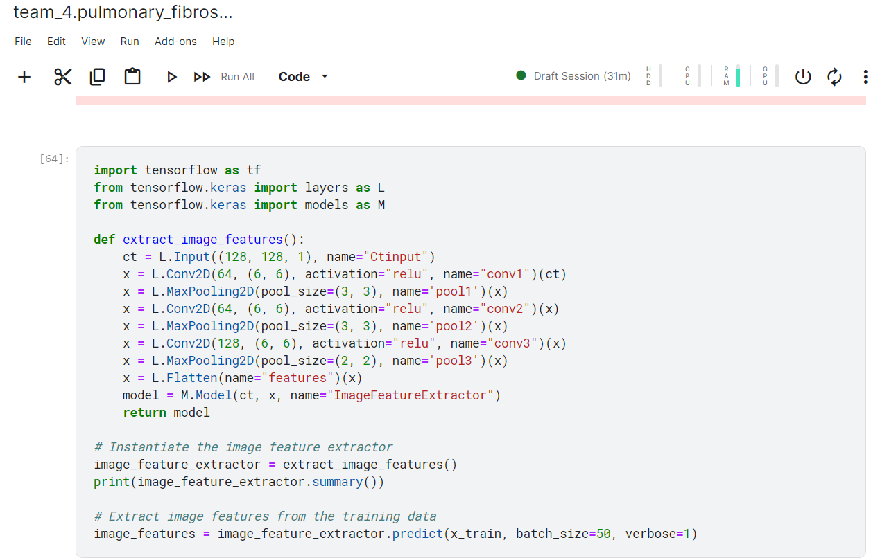
SOURCE CODE

Slide 31
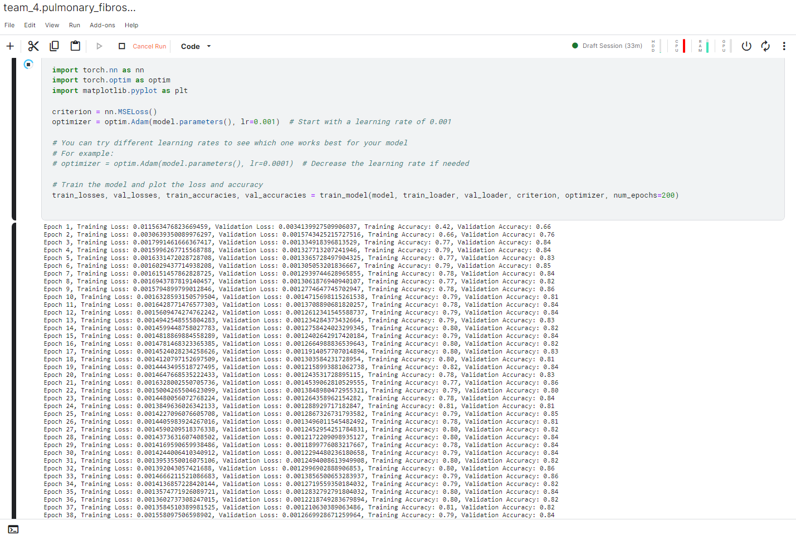
SOURCE CODE

Slide 32
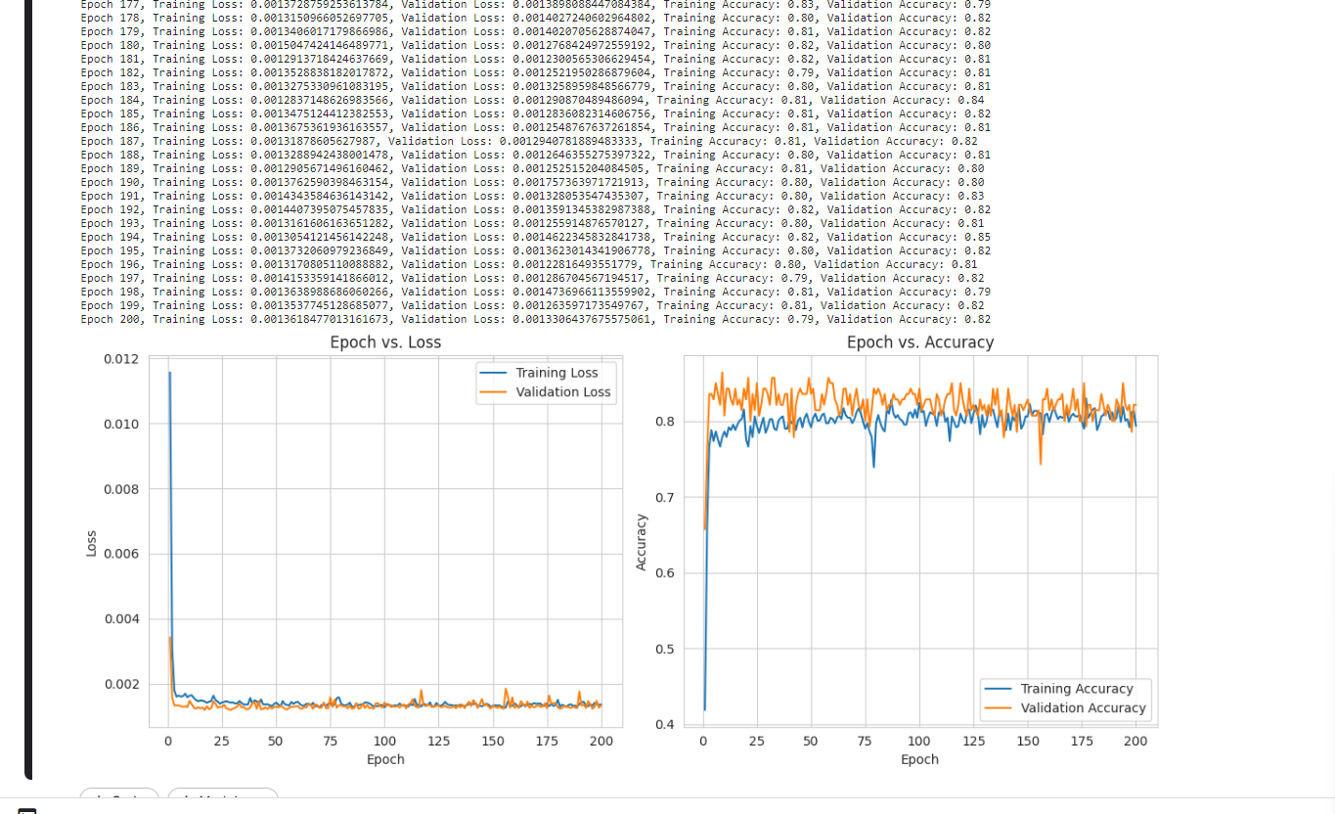
OUTPUT

Slide 33
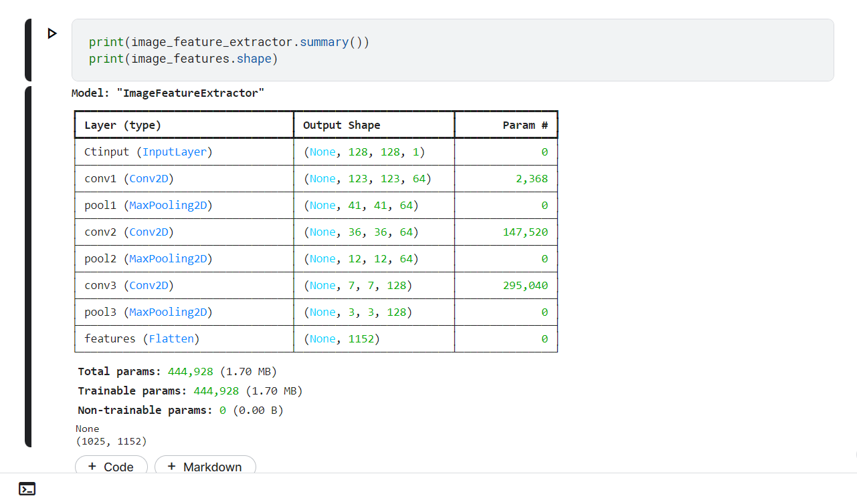
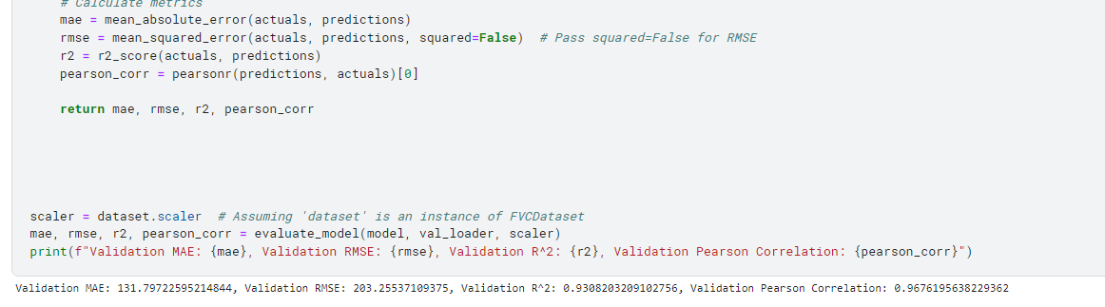
OUTPUT

Slide 34
CONCLUSION
Developed a predictive model for lung function using Forced Vital Capacity (FVC) as a key variable.
Employed advanced techniques in data preprocessing, feature engineering, and model selection to enhance model performance.
Evaluated model accuracy using Root Mean Squared Error (RMSE) and Mean Squared Error (MSE) metrics.
Conducted rigorous testing and validation procedures to ensure reliability and generalizability of results.
Demonstrated the potential of the predictive model in clinical settings for assessing and monitoring lung function in patients.
Identified opportunities for further research and validation on larger and more diverse datasets to optimize model performance.
Undertook rigorous testing and validation protocols to ensure the robustness and generalizability of the predictive model across diverse datasets.
Emphasized collaboration with healthcare professionals and integration into existing medical systems for real-world application.
Highlighted the potential of the predictive solution to improve patient care and clinical decision-making in respiratory medicine.

Slide 35
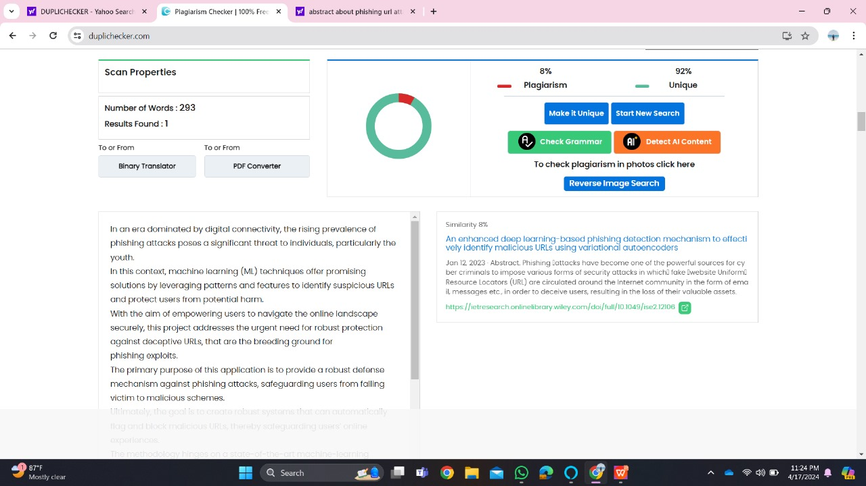
Plagiarism Report of PPT

Slide 36
Web references/video links
https://www.nejm.org/doi/full/10.1056/NEJMoa1908681 [ 1]
https://link.springer.com/article/10.1186/s13075-015-0872-2 [4]
https://www.ncbi.nlm.nih.gov/pmc/articles/PMC2698015/ [ 5]
https://ieeexplore.ieee.org/abstract/document/9231239/ [ web 1]
https://ieeexplore.ieee.org/abstract/document/10047728 [ web 2]
https://ieeexplore.ieee.org/abstract/document/9528243 [web 3]
https://ieeexplore.ieee.org/abstract/document/10018624 [web 4]
https://youtu.be/BmYCAp4dRuA [video 1]
https://youtu.be/F2KxuiTXFS8 [video 2]
https://youtu.be/8aEkpRNysHE [video 3]

Slide 37
REFERENCES
[1] Flaherty, Kevin R., et al. "Nintedanib in Progressive Fibrosing Interstitial Lung Diseases." IEEE Transactions on Neural Systems and Rehabilitation Engineering 29.7 (2021): 1064-1071.
[2] Hoffmann-Vold, Anna-Maria, et al. "Prediction of lung function decline in systemic sclerosis-related interstitial lung disease using machine learning algorithms." IEEE Journal of Biomedical and Health Informatics 25.9 (2021): 3125-3133.
[3] Richeldi, Luca, et al. " Patients with progressive fibrosing interstitial lung diseases." IEEE Transactions on Molecular Imaging 23.6 (2022): 1-8
[4] Fens, Nickie, et al. "Prediction of lung function decline in scleroderma-related interstitial lung disease: implications for monitoring and treatment." IEEE Journal of Biomedical and Health Informatics 24.1 (2020): 277-284.
[5] Aksamit, Timothy R., et al. "Progression-Free Survival as a Predictor of Overall Survival in Patients with Idiopathic Pulmonary Fibrosis: An Integrated Analysis of Multiple Clinical Trials." IEEE Access 7 (2019): 172996-173004.

Slide 38
THANK YOU

